Slide 1

H1B Visa Application Analysis
Project – 1
Manasvi Mittal, Shrishail Kandi, Vikram Bhardwaj, Syed Hussain

Slide 2

About H1B
H1B is a US visa under the Immigration and Nationality Act that allows U.S employers to temporarily employ foreign workers in specialty occupations.
Created in 1952 when the congress passed the Immigration and Nationality Act.
The visa was called an H-1 visa because it had been made into law by section 101(15)(H)(1) of the Immigration and Nationality Act.

Slide 3




Data Processing and Cleaning

Slide 4
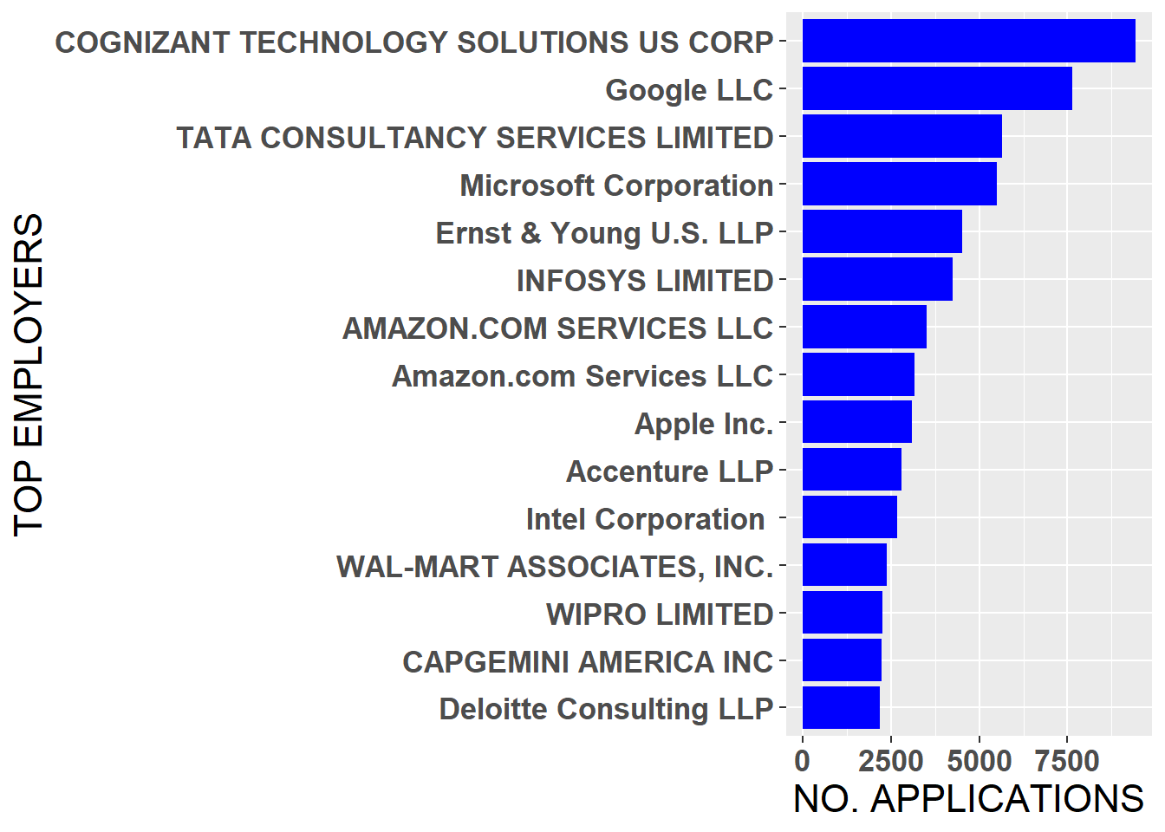
Employers with highest number of H1B Applications
Apart from the technology giants such as Apple, Amazon, Google.. IT service companies like TCS, Cognizant, Infosys Limited are the major employer group sponsoring H1B visas.

Slide 5
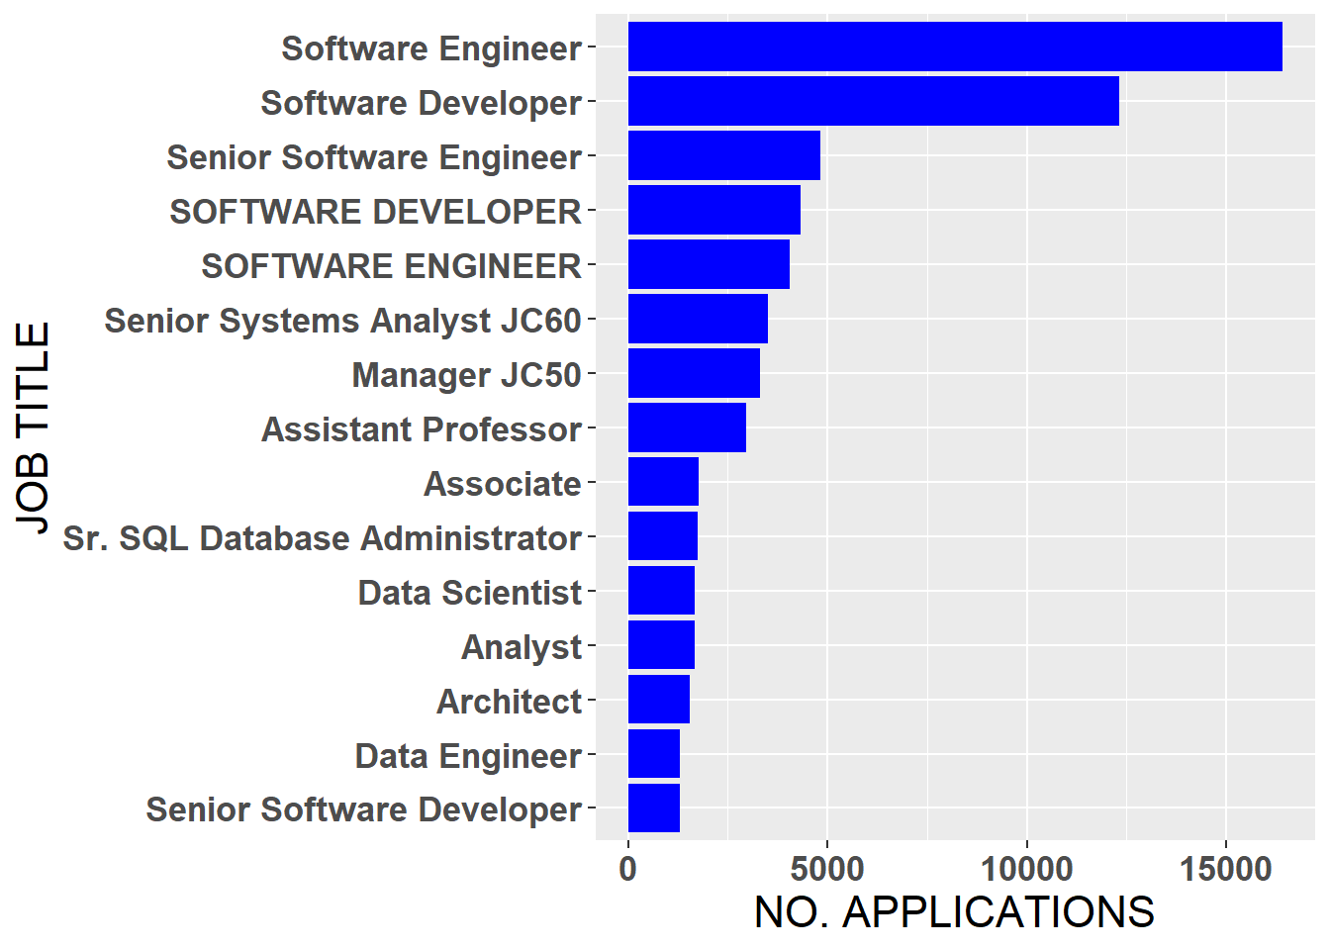
Common Roles for H1B Visa Application
H1B Visa applicants in the software industry with the highest number of applications being filed for software engineer or software developer roles.
Applicants for Data Scientist and data engineering roles are comparatively quite less as compared to the core software roles.

Slide 6
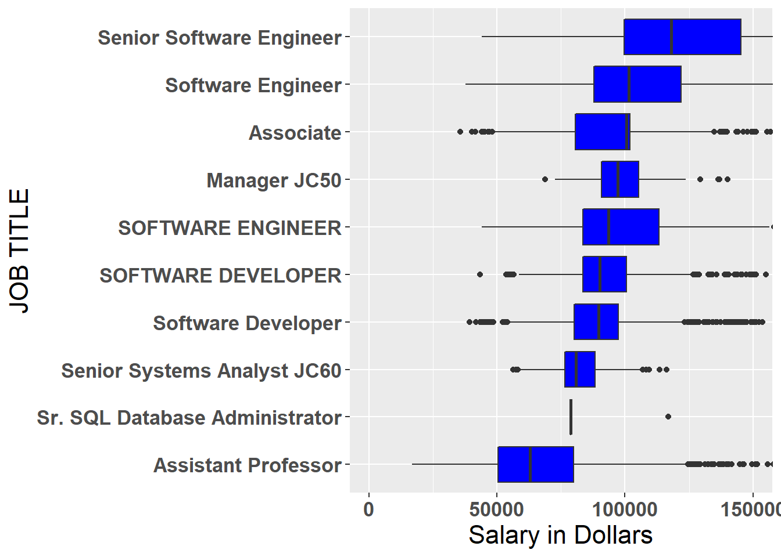

Median wages for Common roles amongst H1B applicants

Slide 8
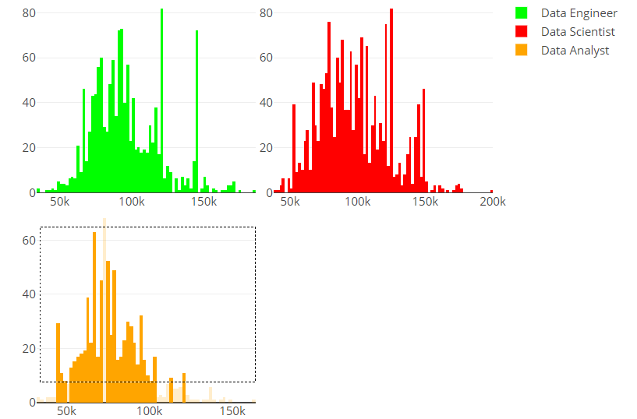
Wage Distribution of applicants applying for beginner jobs in the Data Domain
We further analyze salary distribution for different beginner data domain roles in detail. The range of wages for specialized roles such as data scientist or data engineer can vary from as low as 50k to as high as 150k. Majority of wages for these specialized role lie in the region of 80-120k.
In case of data analyst, the story is different, the distribution of the wages is mostly concentrated in the 60-80k region with a few outliers going above a 100k salary. This helps us assert the fact that more applicant with more specialized roles in the data domain get paid more.

Slide 9
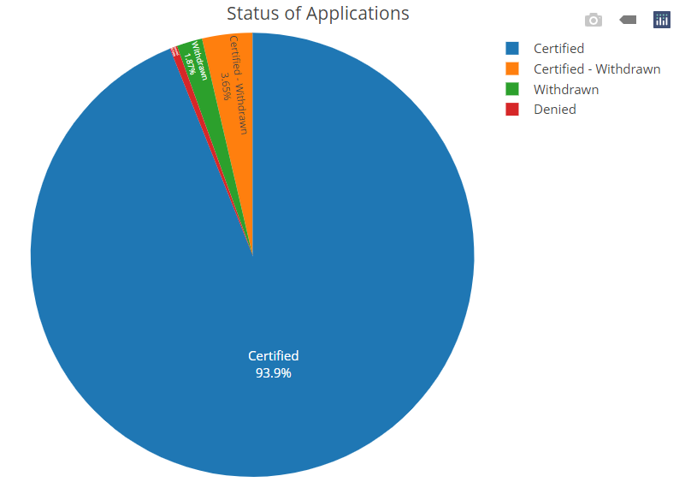
Distribution of Applicants based on the status of their application
The data amongst the selected applicants for H1B 93.9% were approved for further processing, about 3.56% applicants had their visa application certified and withdrawn,
It happens mostly when the employer terminates the job of the applicant and .5 % of the selected applicants were rejected due to certain issues in the applications.
This shows that majority of H1b visa applications are genuine and pass through the scrutiny of the United States government.

Slide 10
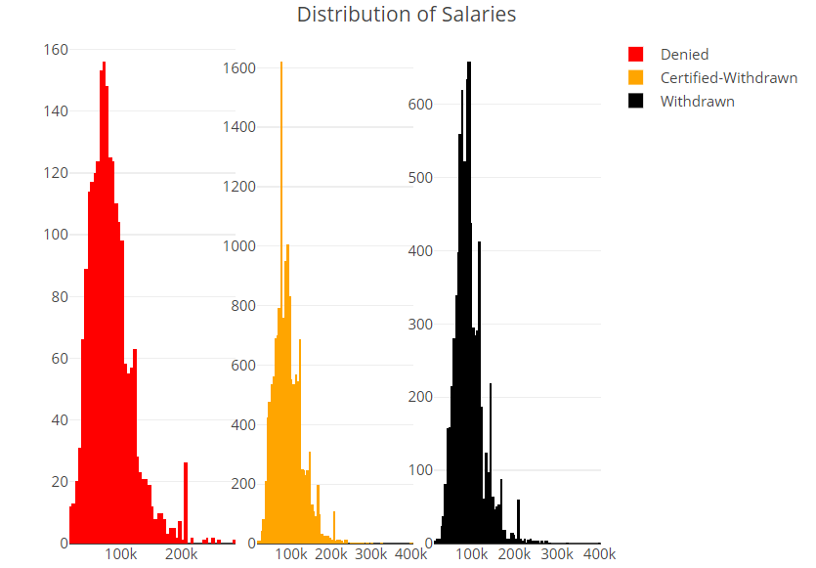
Distribution of Wages for Applicants whose Application were later changed
Mostly the denied applications tend to have salaries lower than 100k dollars as shown.
Lower salary is a red flag and applicants with lower salaries might be spurious or not meet the requirements required by the US Government to be applicable for H1B visa status.

Slide 11
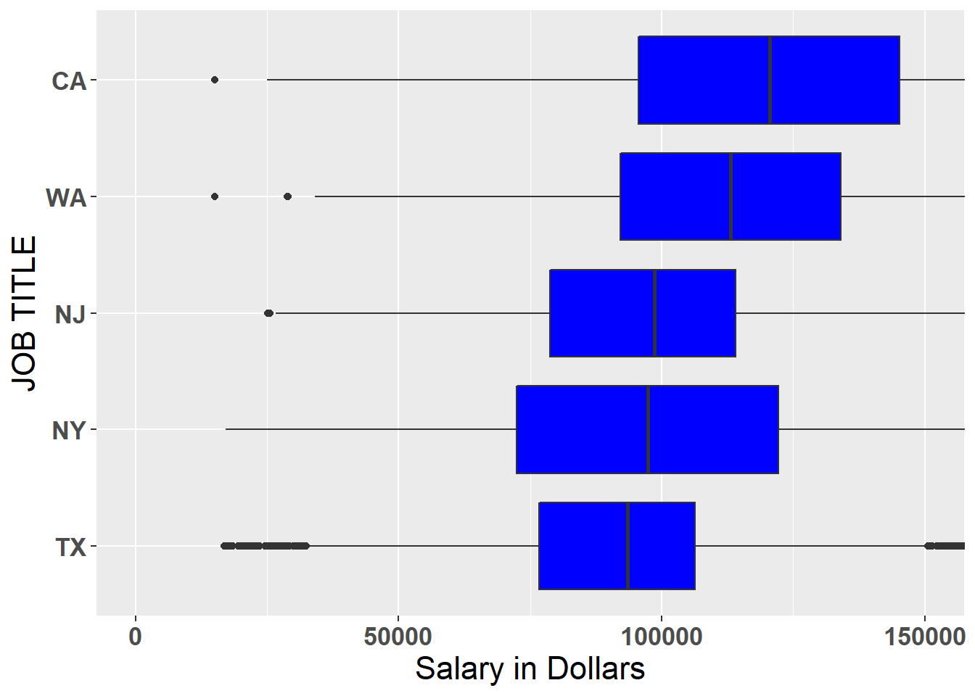
Distribution of wages amongst the states with the highest number of H1B fillings
The state of California has one the highest median salary amongst all states. The median salary of applicants applying from California is north of 100k dollars.
The same is the case with the state with second highest median salary i.e. Washington.
The state with the least salary amongst state with highest number of filings is Texas with a median salary in the range of 80-90k.
states

Slide 12
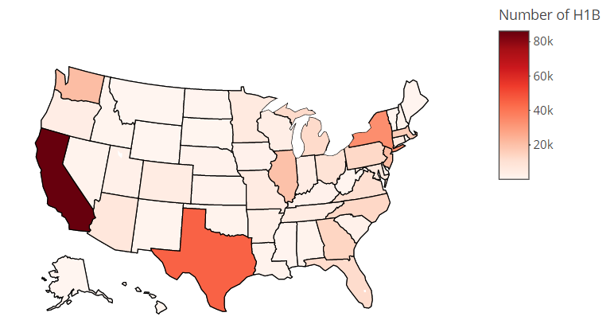
H1B Applicants Geographical Concentration
As evident, the coastal states account for most number of applications such as CA, WA, NY
Texas is a state with highest number of H1B visa applications in the south, which is not on either of the coasts.
H1B visas are generally based on the demand for employees in a particular geographic area.

Slide 13
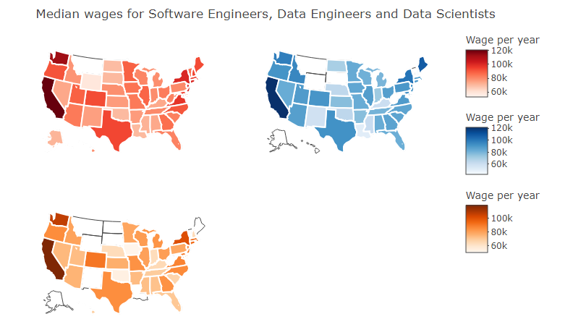
Distribution of yearly wage for Data Engineering, Data Scientist and Software Engineering
As evident from the graphs, states such as CA, TX, WA and NY are the highest paying states for the above stated roles.
The median salary in these states range from 120k in CA to around 100k in TX.
Some states such as MT and WY are outliers in this case as there were no applications filed for H1-B visas for the above three job roles.

Slide 14
